Slide 1
Robotic toolbox

Slide 2
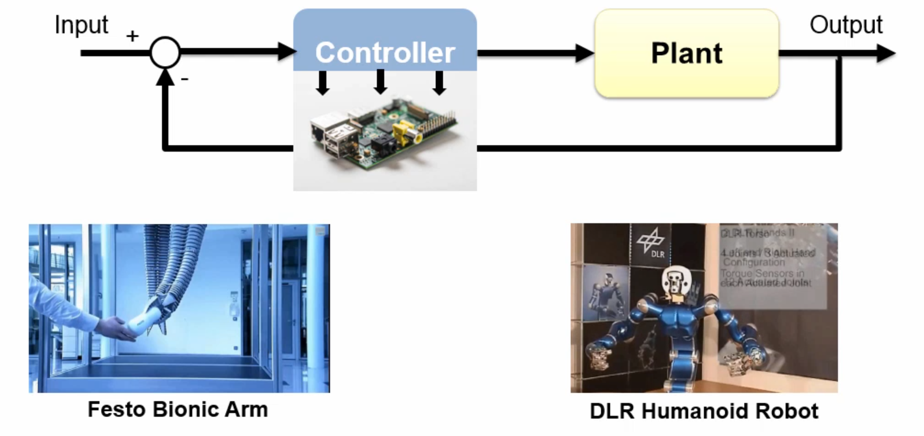
Using matlab and Simulink for building robots

Slide 3
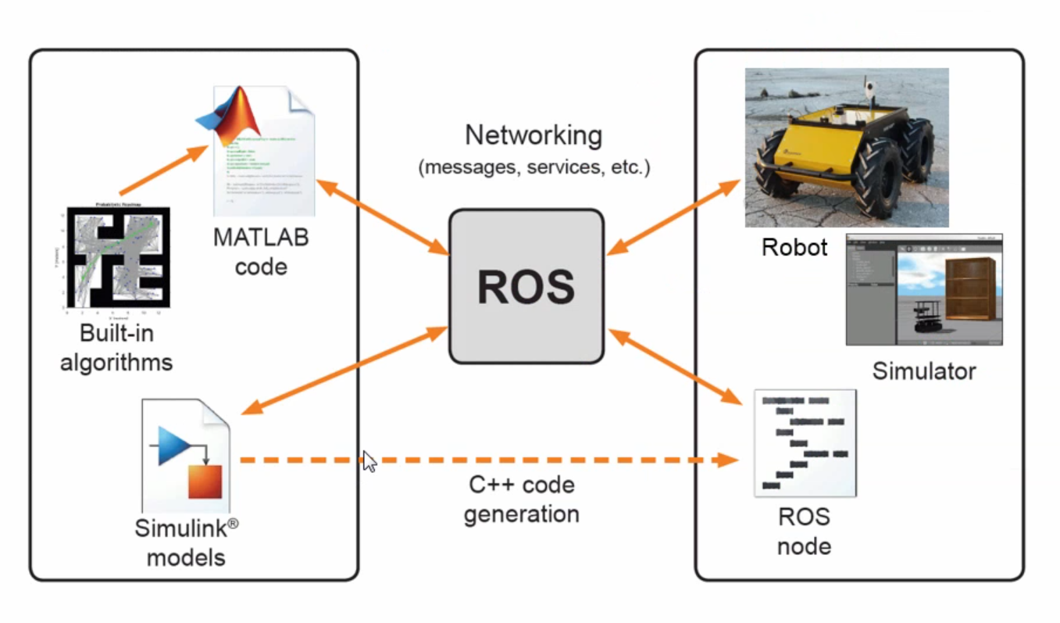
ROS

Slide 4
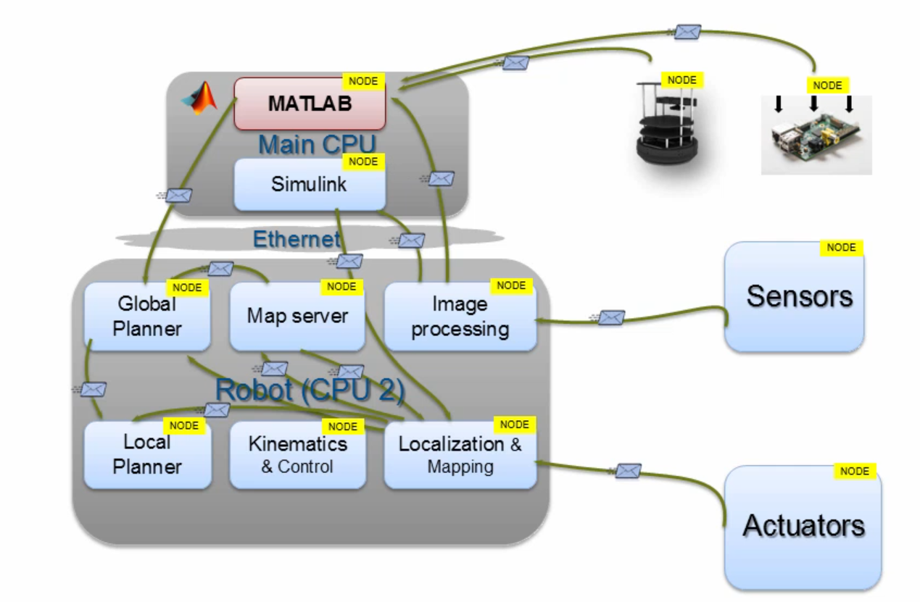
Developing robotic applications with ros

Slide 5
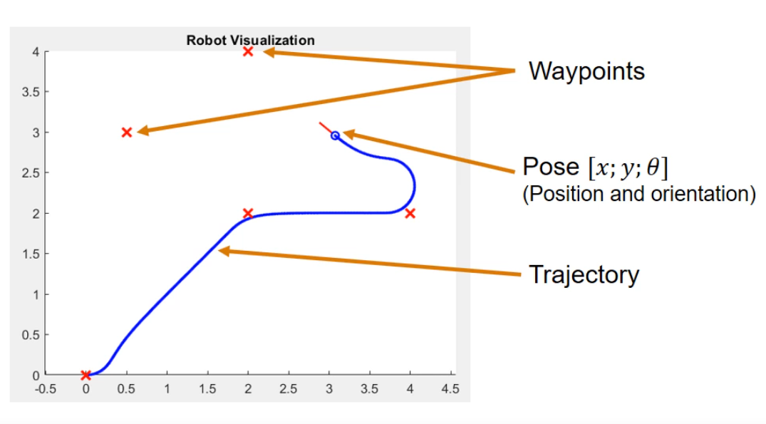
Mobile robotic simulation toolbox

Slide 6
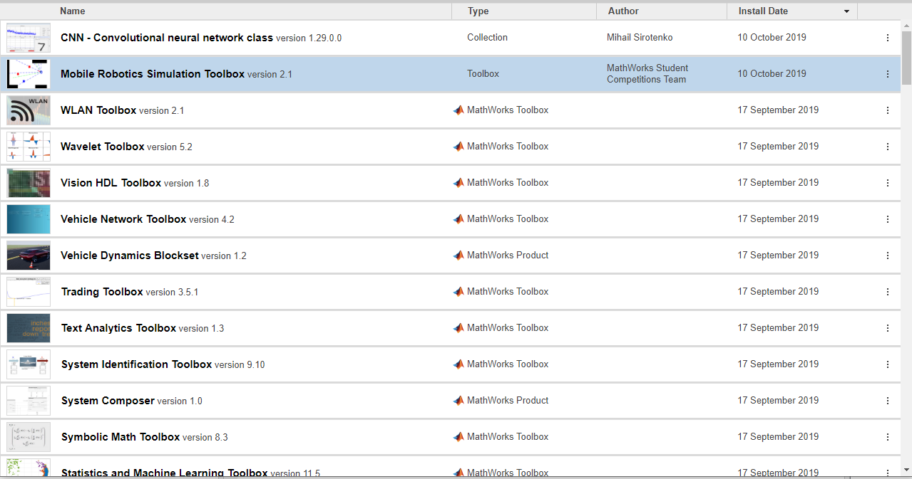
Mobile robotic simulation toolbox

Slide 7
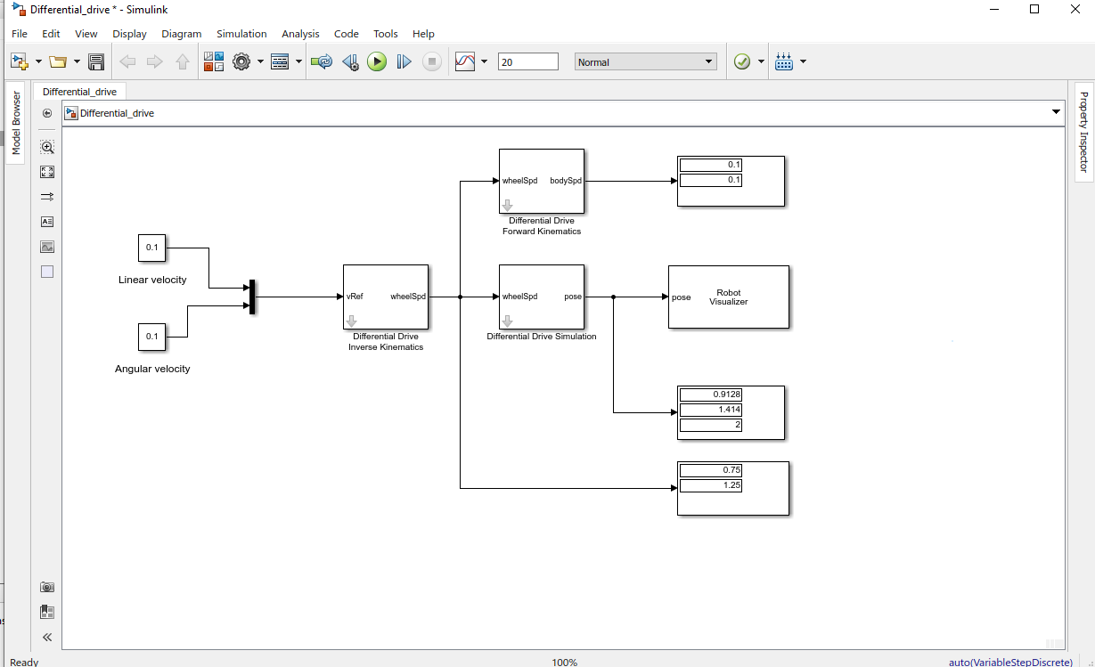
Kinematic models

Slide 8
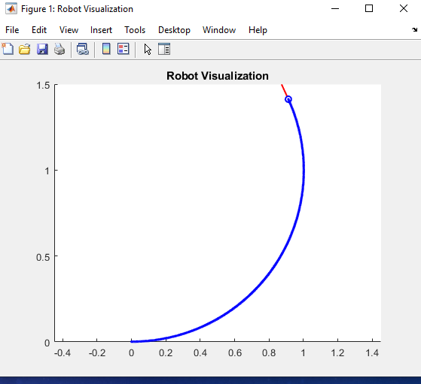
Kinematic models

Slide 9
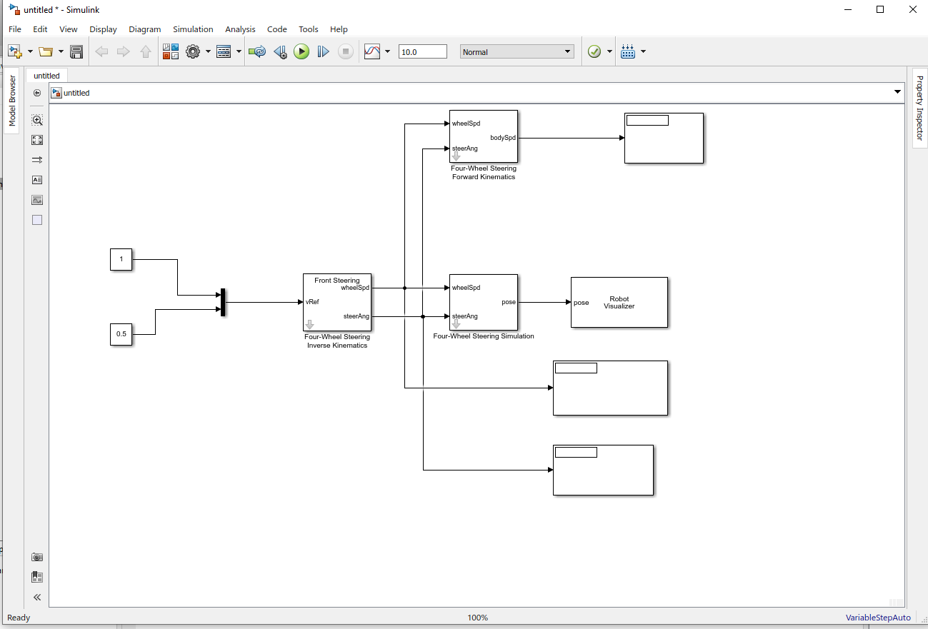
Four-wheel steering

Slide 10
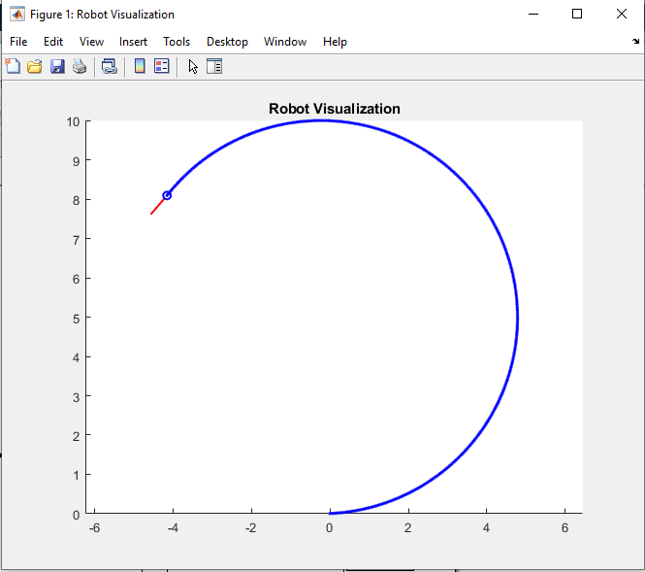
Four-wheel steering

